Slide 1
Fintech – Current Legal Implications and Future Challenges
Webinar: CLPD ACCREDITED
Speaker: Dr.Laura Voda
Date: 15.09.2020
Time: 11:00am – 12:00pm
Copyright © 2020 Fichte & Co

Slide 2
AGENDA
Introductory
11:00 – 11:30 – Presentation
11:30 – 12:00 – Live Q&A
Concluding remarks
Copyright © 2020 Fichte & Co

Slide 3
Transition to a Cashless Society
FinTech has a joint, hybrid nature, representing a “union” between financial services and information technology. Fintech aims at challenging a paradigm – the traditional way of offering financial services.
The sector comprises financial payments services, as well as crypto assets / cryptocurrencies, wealth management, aggregation or acquiring services, lending, crowdfunding, offerings.
FinTech spans various areas of law including finance, technology, tax, compliance, IP, M&A, corporate governance, intellectual property and contracts.
It is a market with progressive growth, expected to reach worldwide 300 billion USD worldwide in the upcoming 3-4 years, due to:
It is a market that attracts investments and
Low cost financial services available, rising the customers’ demand, therefore growing the market
Post pandemic – easiest method of receiving financial services (since many banks have been physically closed).
Copyright © 2020 Fichte & Co
www.fichtelegal.com I info@fichtelegal.com

Slide 4
Overview Of The Legal Framework – UAE Focus
It is a market that can be segmented, since it is very comprehensive: API, AI, crowdfunding, crypto, offerings, blockchain (which is expected to grow soon from Series A to Series B investments in UAE too).
Regulation wise, there are many areas where we may look into:
Financial services regulation
Corporate regulation
Data regulation etc.
For financial services specifically:
SCA:
Fintech Pilot Licenses 2018, Regulatory Framework for Stored Values and Electronic Payment Systems 2017, Crypto Assets regulation drafts 2019
Retail PSP: Authorized commercial banks and other licensed PSPs offering retail, Government, and peer-to-peer digital payment services as well as money remittances
Micropayments PSP: PSPs offering micropayments solution facilitating digital payments targeting the unbanked and under-banked segments in the UAE
Government PSP: Federal and local Government statutory bodies offering Government digital payment services
Non-issuing PSP: Non-deposit taking and non-issuing institutions that offer retail, Government, and peer-to-peer digital payment services.
DIFC: DFSA Rulebook
ADGM : FSMR 2015
Both confirm that PSP can be nonbanks.
Copyright © 2020 Fichte & Co
www.fichtelegal.com I info@fichtelegal.com

Slide 5
Legal Trends in the Industry
The Classic Card Acquiring Scheme
Trend 1
2018 – SCA: plan to regulate initial coin offerings (as securities)
Trend 2
Increment In B2C and technology solutions
Trend 3
Plenty of guidelines. Examples: ADGM: “Robo-Advisory”, Crypto Assets
Trend 4
Increment in open banking services
Trend 5
FATF, Data compliance increments (higher compliance)
Processor
Commission
Commission
Card issuer
Aquirer
Interchange
Commission
Card holder
Merchant
Pays by card
Copyright © 2020 Fichte & Co
www.fichtelegal.com I info@fichtelegal.com

Slide 6
Overview of UAE incubators and equity investments in Fintech
ADGM - Regulatory Laboratory (“RegLab”), Fintech Digital Lab (for the creation of APIs)
DIFC - Fintech Hive accelerator
Regulated environments where Fintech innovation and technology can be tested. The regulatory requirements are lower than the full licensing requirements applicable to the traditional financial services companies. Both offer scalability testing of the technology developed.
Disruption: agile innovations such as peer-to-peer lending and crowdfunding, that are threatening to render some traditional banking services obsolete as they provide alternative lending platforms and widen access to capital.
Need to be regarded with reservations. For example, FSMR states in Guidance Note 3.10 that not all ICOs will constitute an Offer of Securities under the Market Rules or FSMR. If the tokens do not exemplify the features and characteristics of Securities, the offer of such tokens is not likely to be an Offer of Securities (each as defined in the FSMR and the ADGM Glossary) and neither is the trading of such tokens likely to constitute a Regulated Activity under the FSMR.
Copyright © 2020 Fichte & Co
www.fichtelegal.com I info@fichtelegal.com

Slide 7
Overall compliance and variations in the compliance requirements
Compliance requirements: COMPREHENSIVE
Legal perspective: GREY AREAS
Vital points: licensing & contracting
Copyright © 2020 Fichte & Co
www.fichtelegal.com I info@fichtelegal.com

Slide 8
Q&A Session
Copyright © 2020 Fichte & Co

Slide 9
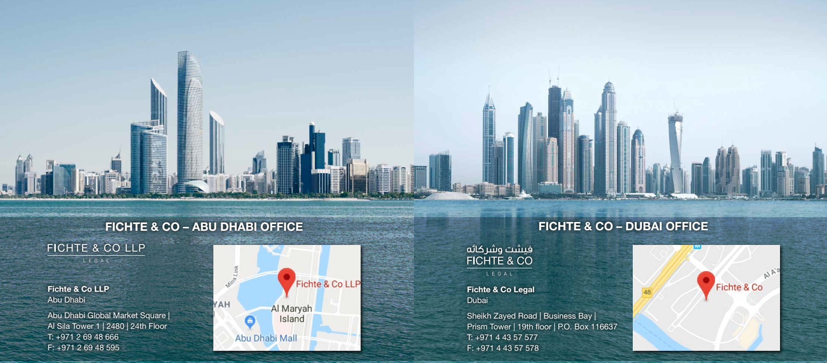
Thank You
Follow us :
Fichte & Co Legal
@fichtelegal
@fichtelegal
Fichte & Co
Copyright © 2020 Fichte & Co
www.fichtelegal.com I info@fichtelegal.com

