Slide 1
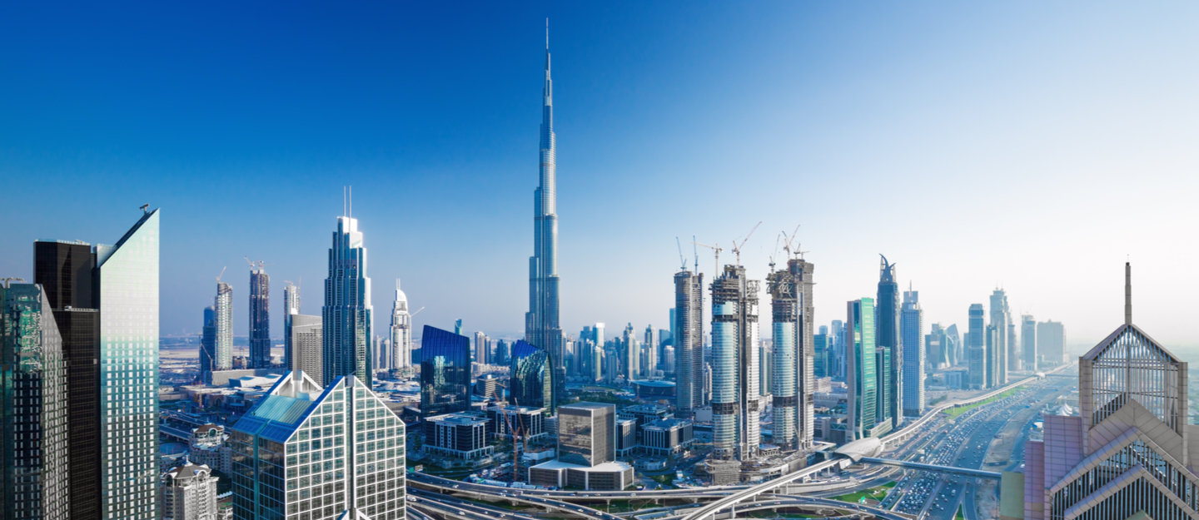

COVID-19 impact on Real Estate Market in the UAE
LIVE WEBINAR
DATE: 14/07/2020
Time: 11:00am – 12:00pm
SPEAKER: Dr. Laura Voda & Mahmoud Ahmed

Slide 2
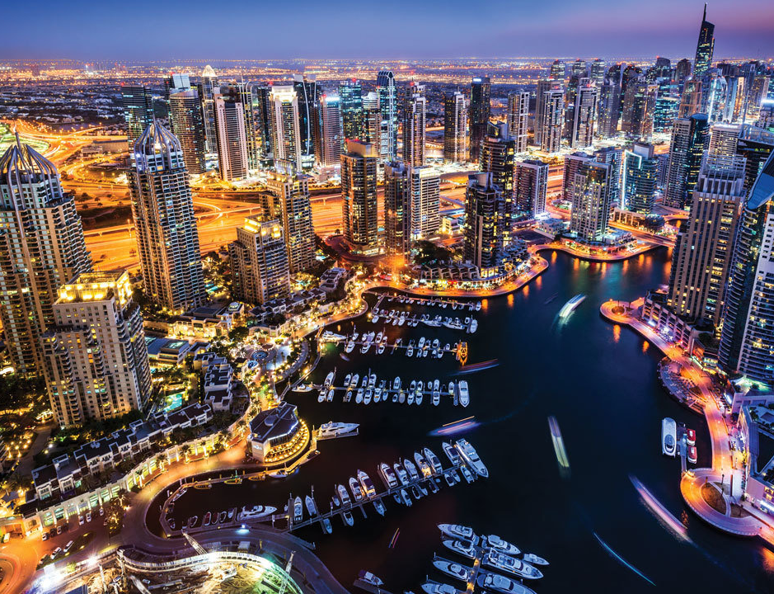
WEBINAR AGENDA
The Corporate Perspective
Dr. Laura Voda
Fichte & Co.
11:00am-11:15am
The Litigation Perspective
Mahmoud Ahmed
Fichte & Co.
11:15am-11:30am
Questions and Answer Session
11:30am – 12:00pm

Slide 3

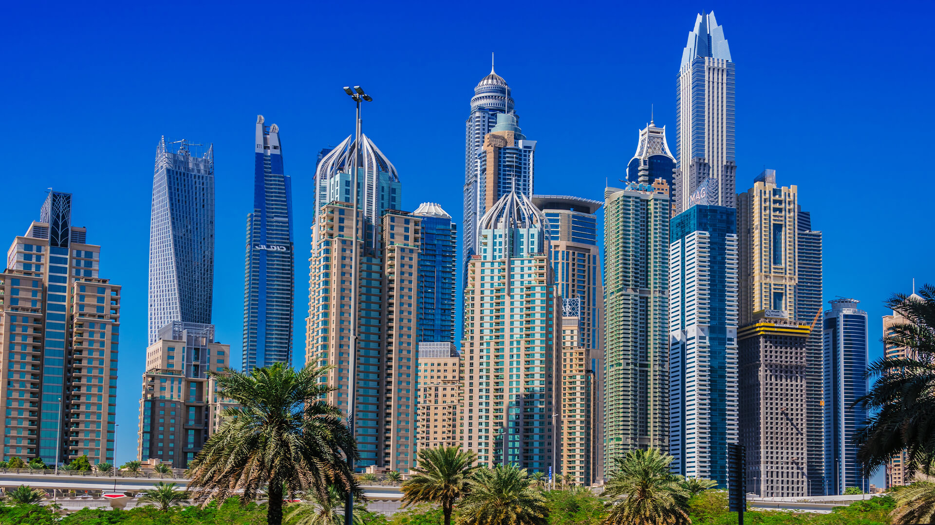
General introduction – Impact on the Real Estate Market of the Current Pandemic
Execution of contracts and “force majeure”
Do we apply Art. 273 or Art. 249 of the UAE Civil Code?
The difference between “hardship” and Force Majeure is that, whereas in the case of Force Majeure, the pending obligation is extinguished and the contract is generally rescinded or terminated, in the case of “hardship” the judge has the right to reduce the burden to the debtor, without necessarily terminating the contract that generated the obligations.
Higher or lower number of transactions?
Mortgages lenience is granted by major financial institutions in the country, as well as by the regulators.
More advisory is needed and amendments in the contracts in relation to what can constitute an objective impossibility to perform.
Copyright © 2020 Fichte & Co
www.fichtelegal.com I info@fichtelegal.com

Slide 4
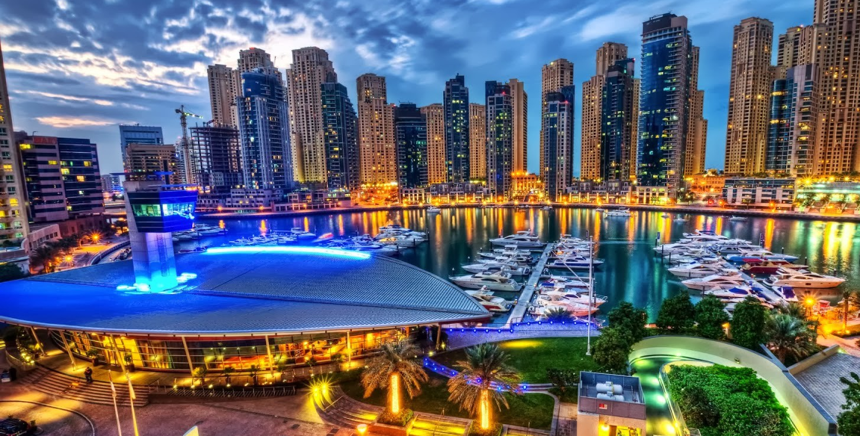
Contractual consequences – very visible in Off Plan sales and purchases of properties
Premises:
a) The construction works did not stop as such during the precautionary measures; however the liquidity of the investors has diminished;
b) Can the real estate developers use this as an inflation hedge?
Responses:
So far, we have little jurisprudence available, however we have a rich negotiation practice and observed that developers tend not to grant lenience to the buyers in the current situation.
Copyright © 2020 Fichte & Co
www.fichtelegal.com I info@fichtelegal.com

Slide 5


Options for the Developers
Developers have the right to terminate off plan sales to defaulting buyers. No court order is needed.
Law No. 19 of 2017, amending Article 11 of Law No. 13 of 2008 on the Interim Real Estate Register in the Emirate of Dubai allows developers to terminate contracts via Dubai Land Departments and make deductions:
Completion status exceeding 80%: the developer may affirm the SPA and request the buyer to execute it. Else, the developer may ask DLD to have the property sold in public auction, the proceeds of such sale being offset with the unpaid balance of the purchase price, in favor of the developer or, in the most severe case, the developer may terminate the SPA unilaterally and retain 40% of the purchase price. Amounts paid by the buyer in excess of the 40% threshold would need to be returned by the developer;
Completion status between 60%-80%: the developer has the right to retain 40% of the purchase price and return the exceeding amounts to the buyer;
Completion status below 60%: the developer has the right to retain 25% of the purchase price and return the exceeding amounts to the buyer;
Copyright © 2020 Fichte & Co
www.fichtelegal.com I info@fichtelegal.com

Slide 6
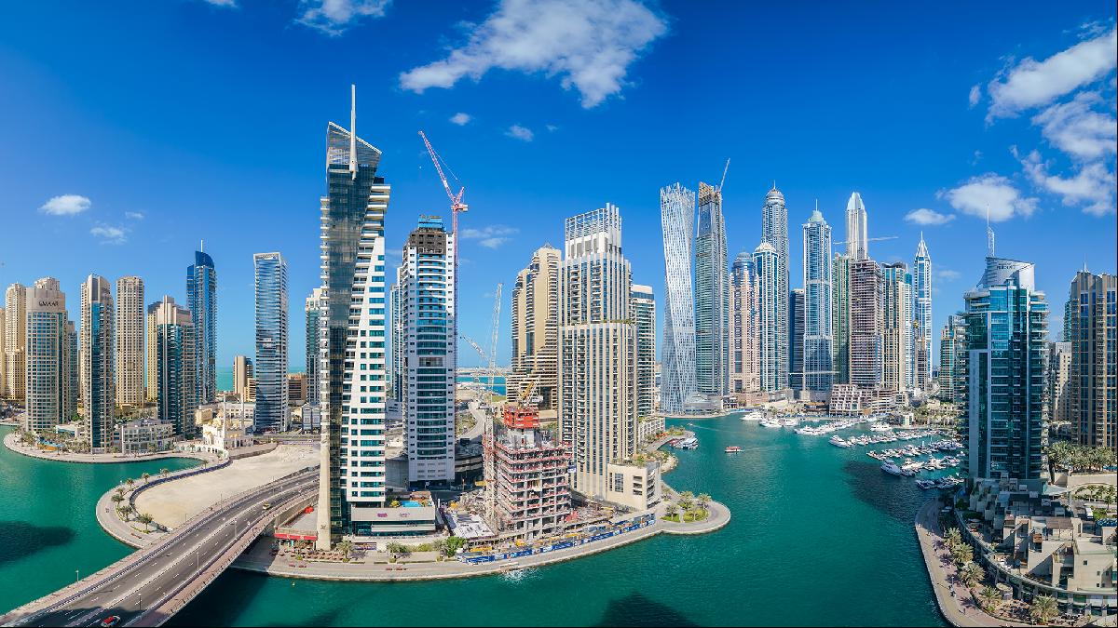
What if projects are stalled in this period or became cancelled as a result of the pandemic?
Article 23 of Executive Council Resolution No (6) of 2010 sets out the nine grounds under which RERA can cancel a project, these include but are not limited to, events where the developer has obtained all the necessary approvals to start construction works and yet has failed to do so; instances where in contravention of Article 16 of Law No. 8 of 2007, the developer has mismanaged the project’s escrow account; and when the developer fails to complete the work due to his own gross negligence.
After the cancellation of the project, RERA will draft a report setting out the reasons for cancellation and address the said report to the developer. In turn a RERA appointed auditor will review the escrow account and request the developer or the escrow agent, to distribute the available funds to the purchasers within 14 days of the cancellation. The auditor’s fees will be met by the developer as stipulated in article 25 of the decree.
Article 26 of the Resolution provides that in the event of a shortfall between the monies refunded to the purchasers and that which they had initially paid, the developer will be given 60 days from the day of the cancellation, extendable at RERA’s discretion, to pay the shortfall. The Dubai Courts Execution section will have authority to implement the decisions of the committee as provided by Article 5 of the Decree.
Result for investors: investor to file a petition to the DLD department who will in turn forward the request to the committee. The latter will then contact the investor to acknowledge the claim and inform him of the date of a hearing before Dubai Courts in order to have the amounts paid reimbursed from the escrow account of the projects or from other executable proceeds of the cancelled project.
Copyright © 2020 Fichte & Co
www.fichtelegal.com I info@fichtelegal.com

Slide 7
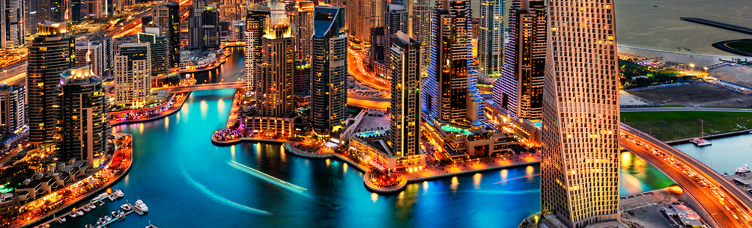
Can the current pandemic be used as a reason justifying the developer’s delay in completing a project?
This point remains debatable as it is highly dependent on the investor’s claims against the developer. It is unlikely that a developer to make a claim against the investor, unless such claim is related to the nonpayment of the price or other defaults of the buyer.
Whether the developer can use the pandemic as a defense accepted in courts and arbitration, it is again early however knowing the nature of the precautionary measures in the construction sector, our suggestion would be to consider this as a hardship and not as a fully exonerating event.
Copyright © 2020 Fichte & Co
www.fichtelegal.com I info@fichtelegal.com

Slide 8

Definition of Force Majeure
Is a common clause in contracts that essentially frees both parties from liability or obligation when an extraordinary event or circumstance beyond the control of the parties, such as a war, strike, epidemic or any event described by the legal term as "ACT OF GOD", prevents one or both parties from fulfilling their obligations under the contract.
And since the World Health Organization has announced that the Coronavirus has been classified as a global pandemic, therefore, the Coronavirus is considered as a force majeure.
Copyright © 2020 Fichte & Co
www.fichtelegal.com I info@fichtelegal.com

Slide 9
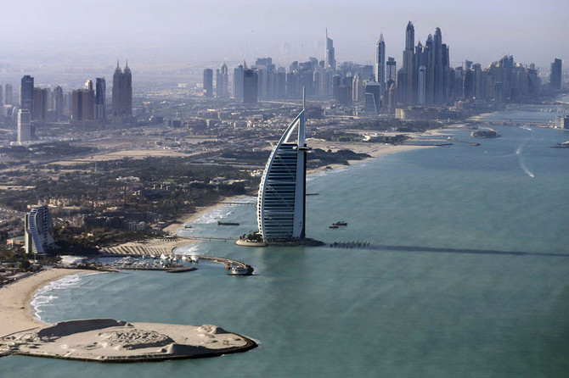
UAE Civil Transactions Law
The tenancy contract is a type of contracts binding on both parties, therefore, the general conditions of the contracts which mentioned in the Civil Law applied on it, especially the following articles:
Article (249):
If exceptional circumstances of a public nature which could not have been foreseen occur as a result of which the performance of the contractual obligation, even if not impossible, becomes oppressive for the obligor so as to threaten him with grave loss, it shall be permissible for the judge, in accordance with the circumstances and after weighing up the interests of each party, to reduce the oppressive obligation to a reasonable level if justice so requires, and any agreement to the contrary shall be void.
Article (273):
(1) In contracts binding on both parties, if force majeure supervenes which makes the performance of the contract impossible, the corresponding obligation shall cease, and the contract shall be automatically cancelled.
(2) In the case of partial impossibility, that part of the contract which is impossible shall be extinguished, and the same shall apply to temporary impossibility in continuing contracts, and in those two cases it shall be permissible for the obligor to cancel the contract provided that the obligee is so aware.
Copyright © 2020 Fichte & Co
www.fichtelegal.com I info@fichtelegal.com

Slide 10
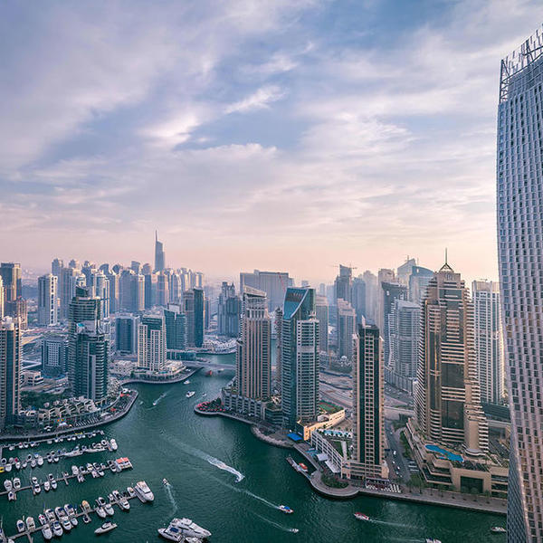
Rental Dispute Center
The Rental Dispute Center is the judicial arm of Dubai Land Department, and in the light of the Corona pandemic and the current exceptional circumstances, the Center has created a new judicial circuit to consider the cases which are filed by the tenants to terminate the lease contracts or reduce the rent value.
Article No. (7) of the Law No. (26) of 2007 Regulating the Relationship between Landlords and Tenants in the Emirate of Dubai states that if the Lease Contract is valid, it may not be terminated during its term by the Landlord or the Tenant. It can only be terminated by mutual agreement or in accordance with the provisions of this Law.
Also, Article No. (13) of the same law stipulates that the Landlord and Tenant may, prior to the expiry of the Tenancy Contract, amend any of the terms of the Tenancy Contract or review the Rent, whether increasing or decreasing it. Should the Landlord and Tenant fail to reach an agreement, then the Tribunal may determine the fair Rent.
Copyright © 2020 Fichte & Co
www.fichtelegal.com I info@fichtelegal.com

Slide 11

So what can we do?
Accordingly, a balance should be stricken between the Landlord’s interest and the Tenant’s interest, and no one can force the Landlord to have the leased premises occupied by the Tenant who is not paying the rent.
HOWEVER, this is not a green light to all tenants to seek to early terminate their contracts or ask for a reduction in the rent amount. This right is given only to the tenants who can provide the center with all the satisfactory evidence and documents which prove that their financial position has currently affected by the COVID-19 pandemic and they are no longer able to perform their contractual obligations. The center examines each claim on a case to case basis.
Therefore, the Landlord still has the right to file his claim before the center to seek to evacuate the leased premises and order the Tenant to pay all the outstanding rental amount till the date of evacuation.
.
If the Tenant is facing exceptional circumstances due to the coronavirus pandemic such as when he/she loses his/her job, or his/her business generates no or very limited revenues to be a in position to be able to pay the rent. The tenant can also approach the center and file a claim asking for early termination of the contract without penalty or asking to reduce the rent amount bearing in mind the situation created by the COVID-19 pandemic.
OR
Copyright © 2020 Fichte & Co
www.fichtelegal.com I info@fichtelegal.com

Slide 12


Thank you
Q&A Session
Copyright © 2020 Fichte & Co

Slide 13
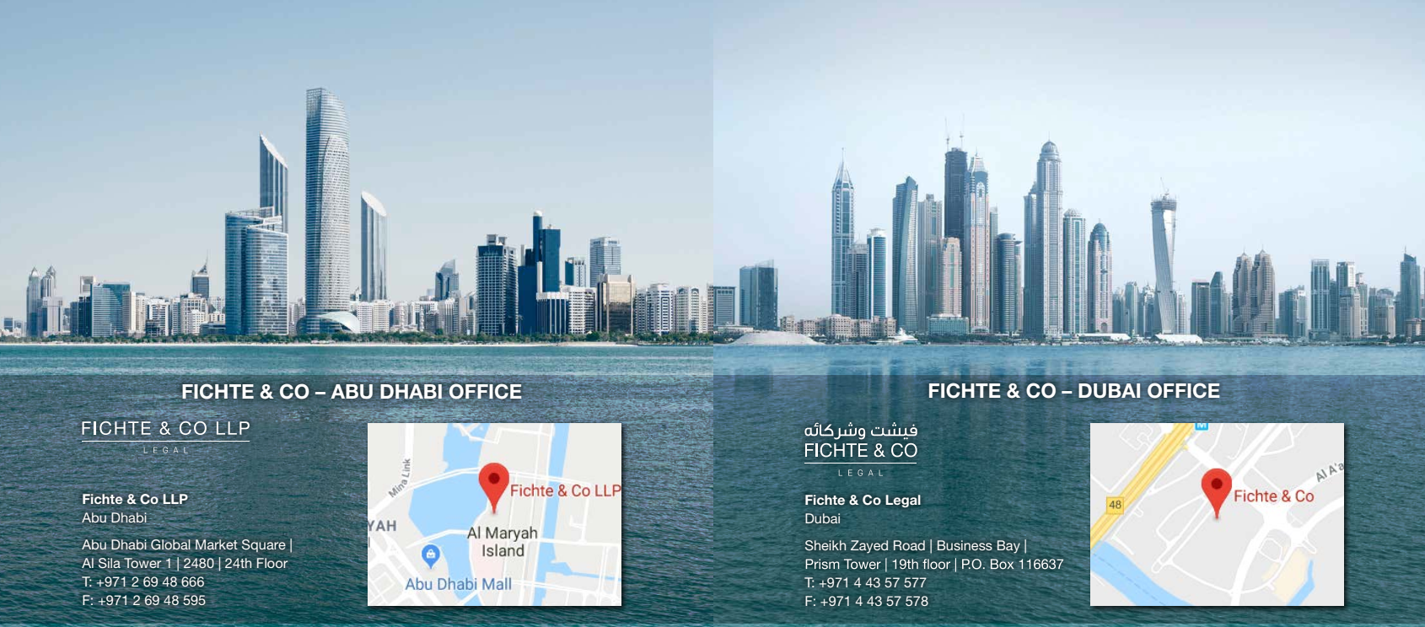




Thank You
Follow us :
Fichte & Co Legal
@fichtelegal
@fichtelegal
Fichte & Co
Copyright © 2020 Fichte & Co
www.fichtelegal.com I info@fichtelegal.com

