Slide 1
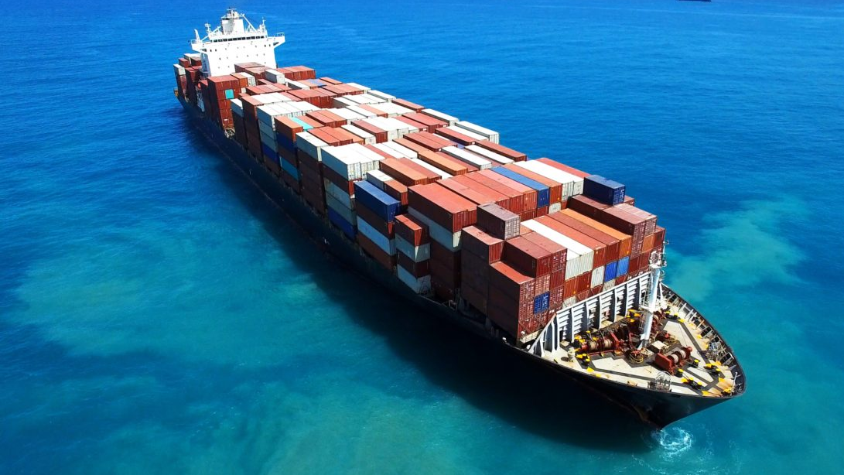
COVID-19 and Shipping Industry
LIVE WEBINAR
CPLD ACCREDITED
DATE: 5/5/2020
Time: 11:00am – 12:00pm
SPEAKER: Alessandro Tricoli ( Partner at Fichte & Co )

Slide 2
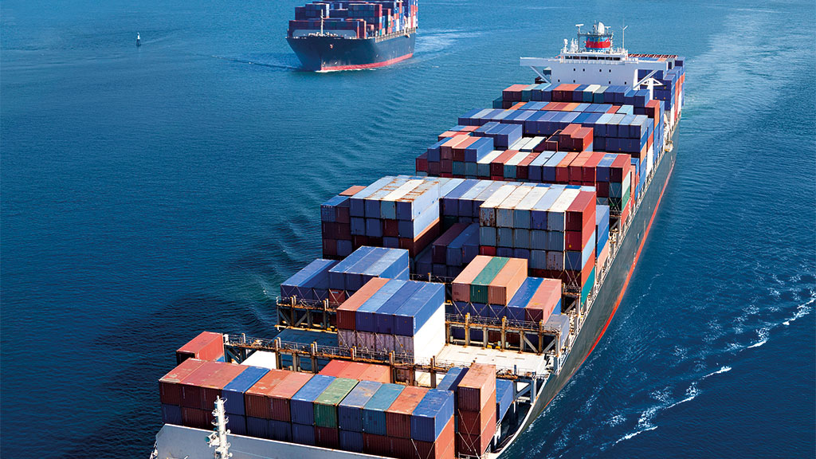
WEBINAR AGENDA
Presentation – 11:00am – 11:30am
Current major legal implications in the shipping industry.
Analysis of the impact on global economy and shipping market in particular.
Take away guidance: contract flexibility and how to improve contingency plan.
Questions – 11:30am – 12:00pm
Q&A session.

Slide 3
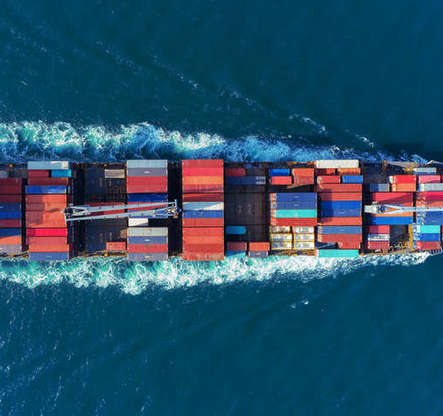
The coronavirus outbreak has created major disruptions
Possibility of global recession
Transportation complications
Geopolitical concerns
Security issues
Legal issues
Copyright © 2020 Fichte & Co
www.fichtelegal.com I info@fichtelegal.com

Slide 4
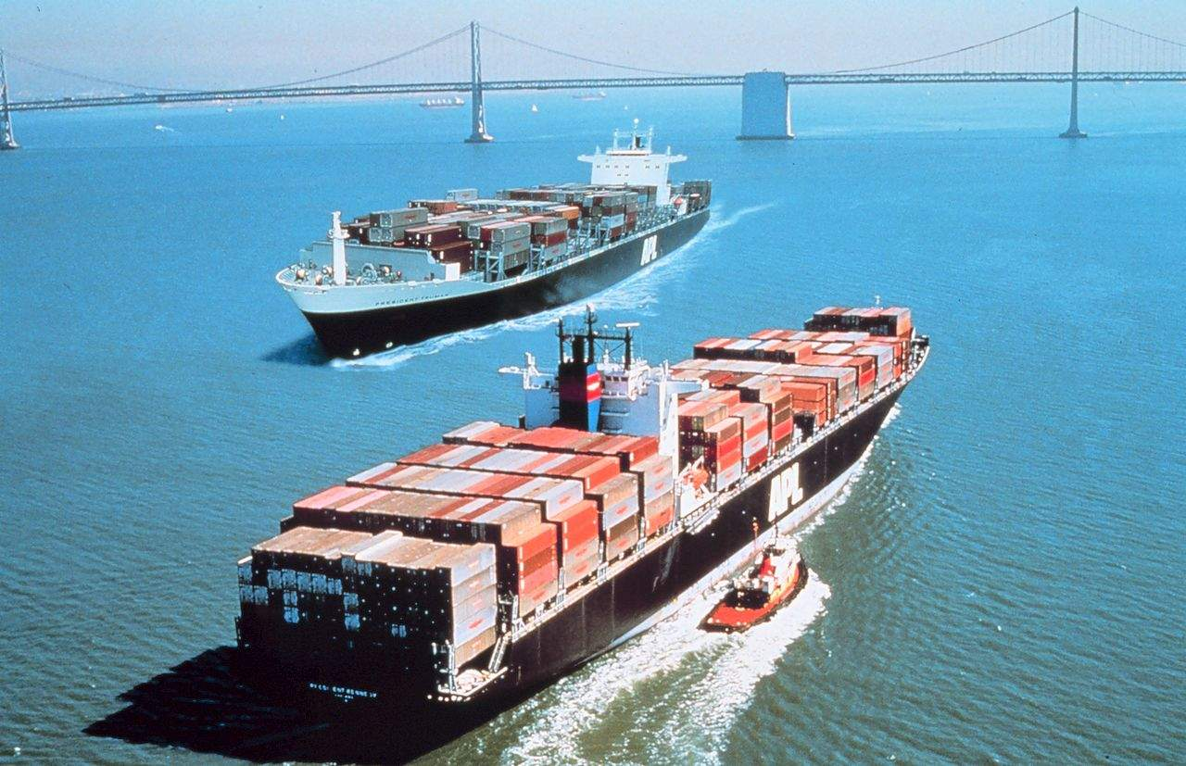
Who are affected by the impact and how?
Shippers
Traders
Ship-owners
Brokers
Container and dry bulk shipping services
Shipping operational personals of ports/terminals
Crew
Copyright © 2020 Fichte & Co
www.fichtelegal.com I info@fichtelegal.com

Slide 5
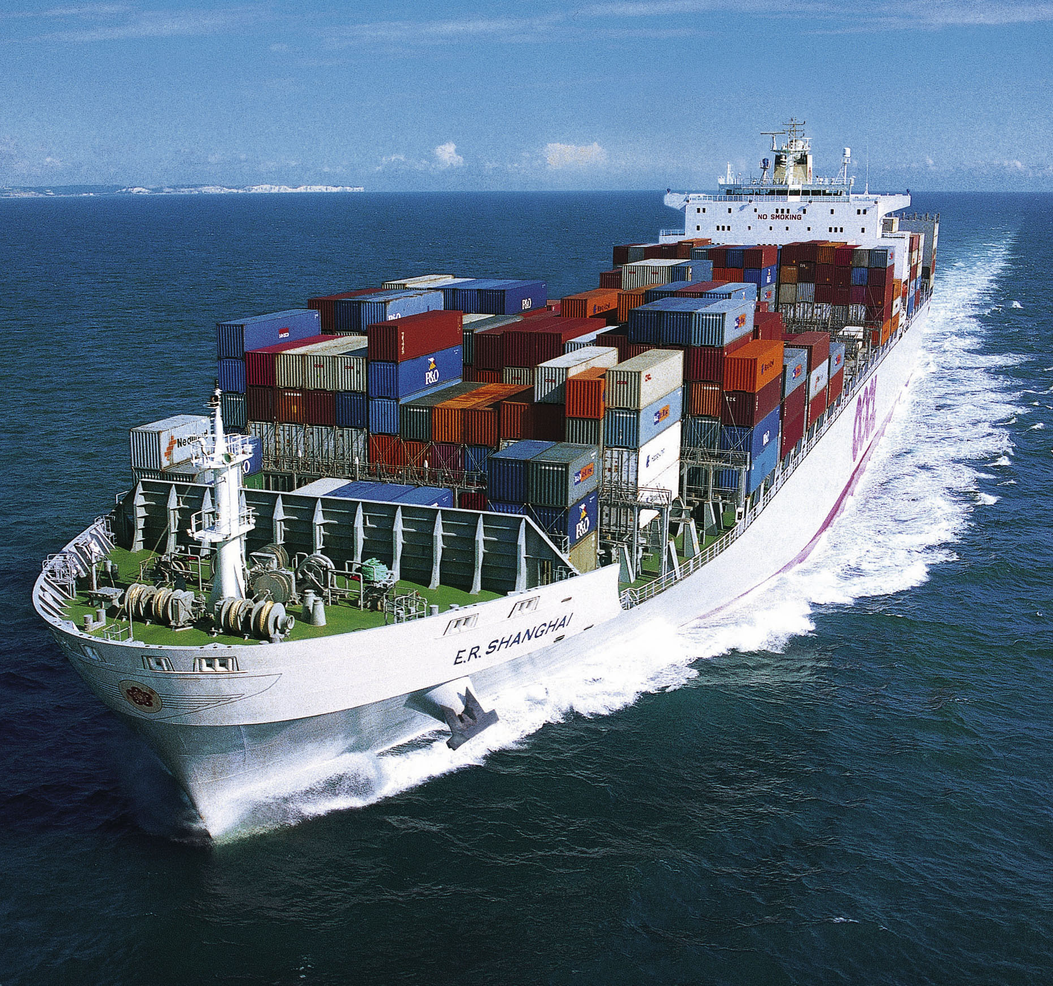
Current major legal implications in the shipping industry
Shipping Contracts – the frustration/force majeure clauses.
Insurance claims.
Disputes.
Port closures.
Delays.
Financing arrangements.
Copyright © 2020 Fichte & Co
www.fichtelegal.com I info@fichtelegal.com

Slide 6
Circulars issued in UAE amid Covid-19
Circular No (7) of 2020
Measures to facilitate ship’s crew change in UAE under special circumstances during Covid-19 pandemic.
Applicable towards all seafarers, port authorities, shipping agents, ship managers, operators and anyone who engage with seafarer’s services in the UAE.
U.A.E. FTA Circular No. 06 of 2020
Reg Guidance relating to extension of seafarer's certificates due to outbreak of COVID-19.
Expired certificates subject to certain criteria is considered valid for a period of 3 months starting from March 26, 2020.
Notice to Agent 35/2020 – Port of Fujairah
Covid 19 Precautionary measures – Port Authority imposed restrictions.
No crewmember can disembark the vessel during her call at Port of Fujairah Offshore Anchorage & Port of Fujairah.
Circular No (8) of 2020
Instructions in regards of unified precautionary measures in UAE to prevent the spread of Coronavirus-COVID 19.
restrictions and measures to be taken for vessels entering drydocks and ship repair yard, recreational craft and wooden vessels.
Copyright © 2020 Fichte & Co
www.fichtelegal.com I info@fichtelegal.com

Slide 7
Analysis of the impact on global economy and shipping market in particular.
Impact on the global supply chain.
Reduction in container volumes / capacity.
Decrease in accessibility of equipment / machinery.
Port entry restrictions / construction halted.
Lower freight rates / less demand and supply.
Additional charges / Congestion in ports.
Adjournments with loading and unloading cargo.
Affected cruise industry - Diamond princess.
Trade barriers / reduction in vessel routes.
Quarantining vessels and crews.
Copyright © 2020 Fichte & Co
www.fichtelegal.com I info@fichtelegal.com

Slide 8
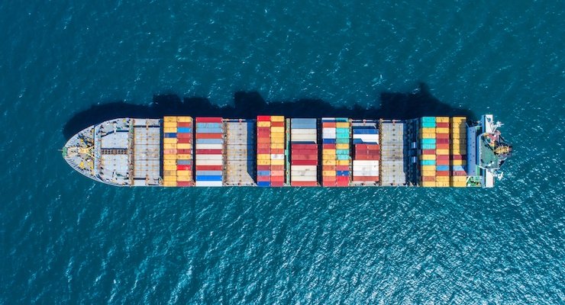
Take away guidance: Contract flexibility
Buy-side provisions.
Service contracts.
Force Majeure provisions.
BIMCO Infectious or Contagious Disease Clause for charter parties.
Suspension / latitude for delays.
Additional / standby suppliers.
Classification and statutory certificates.
What should exist charter parties consider?
Copyright © 2020 Fichte & Co
www.fichtelegal.com I info@fichtelegal.com

Slide 9
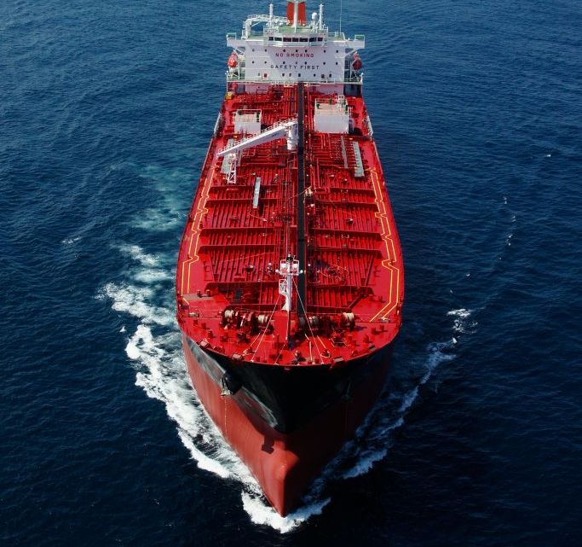
Take away guidance: Drafting a Contingency plan
Which activity is likely to be affected and determining the impact of the affected activity on the vessel's operations.
How to continue operational duties with minimal impact.
In the event the main supplier cannot undergo their responsibilities, who can?
Potential insurance claims.
Who should the Master report to in the event of an emergency?
Locations of the nearest ports to dock.
Determining channels of communication.
How the alterative routes and activities could also be impacted?
If operational activity changes during voyage, what important documents will be needed to document the change.
What procedures might be taken regarding ports, vessels and cargo?
What categories of inspections might be executed?
Copyright © 2020 Fichte & Co
www.fichtelegal.com I info@fichtelegal.com

Slide 10
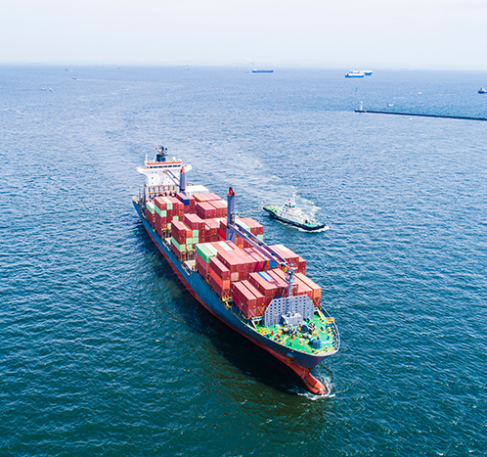
Future of the Shipping Industry?
When will carriers be able to go back to their normal capacities?
What are the long - term effects for existing charterers unable to perform their obligations?
Forecasting the price of fuel.
Calculating Debt.
Determining prices operating costs of the vessels.
How long will the pandemic effect last?
Duration to the disruption of international ocean transport/ trade.
Copyright © 2020 Fichte & Co
www.fichtelegal.com I info@fichtelegal.com

Slide 11
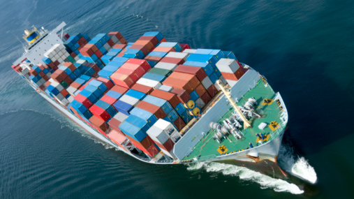
Q&A TIME
11:30am – 12:00pm

Slide 12
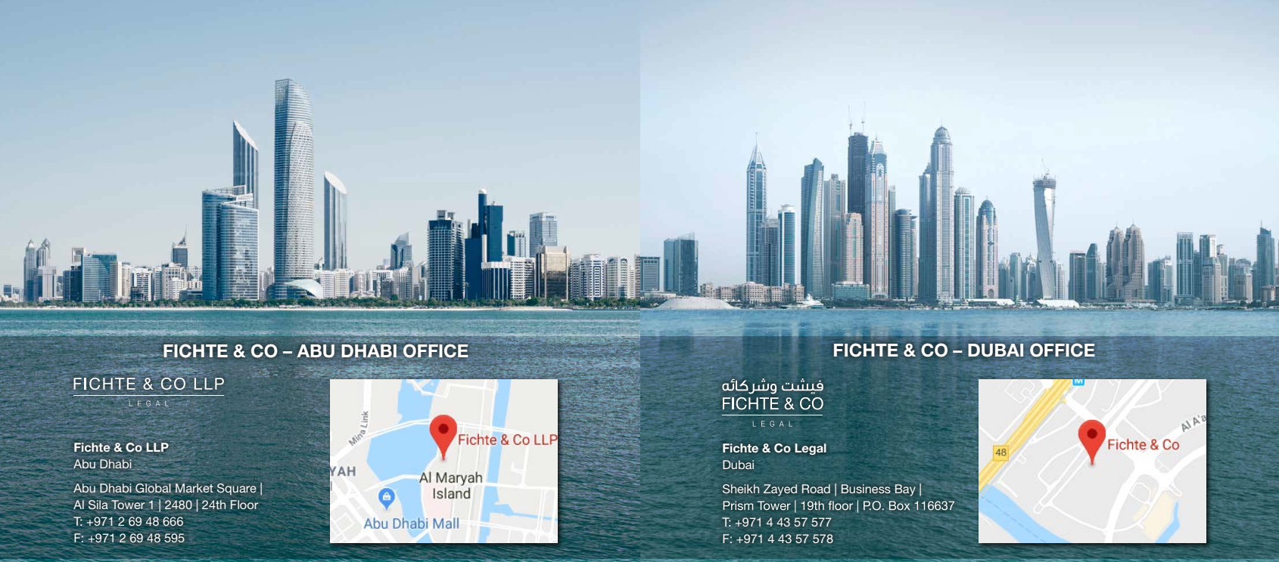
Thank You
Follow us :
Fichte & Co Legal
@fichtelegal
@fichtelegal
Fichte & Co
Copyright © 2020 Fichte & Co
www.fichtelegal.com I info@fichtelegal.com

